Slide 1
CT BCG in R
Erik.Leppo@tetratech.com 2021-07-30

Slide 2
Background
BCG model for CT in Access.
Access db is 32-bit and CT DEEP is using 64-bit Access.
Move metric calculation and BCG model to R.

Slide 3
Tools
Will still need a database or other tool to generate a fully qualified sample taxa list.
Samples with taxa, counts, and master taxa info.
Two R packages
BioMonTools for metric values
BCGcalc for BCG model
Both are hosted on GitHub
https://github.com/leppott/BioMonTools
https://github.com/leppott/BCGcalc

Slide 4
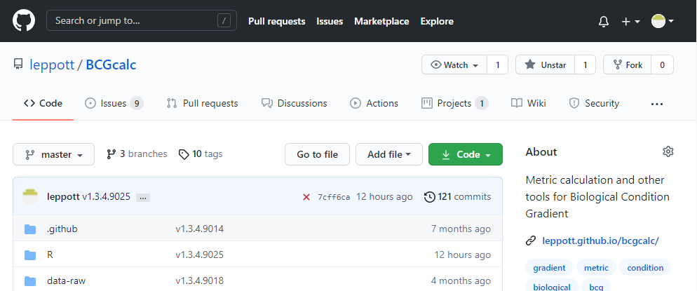
Installing from GitHub
Can be downloaded from the websites (green button)
Can be installed in R
Directions on website
if(!require(remotes)){install.packages("remotes")} #install if needed install_github("leppott/BCGcalc", force=TRUE, build_vignettes=TRUE)

Slide 5
Procedure
Generate fully qualified sample taxa list and save (xlsx, csv, txt, etc).
Import file and use BioMonTools::metric.values() to calculate metric values.
Use BCGcalc::BCG.Metric.Membership() to calculate membership values for each metric.
Use BCGcalc::BCG.Level.Membership() to calculate membership values for each level.
Use BCGcalc::BCG.Level.Assignment() to calculate nominal and secondary levels for each sample.

Slide 6
New Features
BCGcalc::BCG.Level.Assignment includes a proportional level assignment

Slide 7
Additional Notes
An R Notebook is included as an HTML file that documents the procedure with example data.
The procedure for the different biological communities (fish and benthic macroinvertebrates) is the same.
The BCG model rules are included in the BCGcalc package in Rules.xlsx

